Slide 1
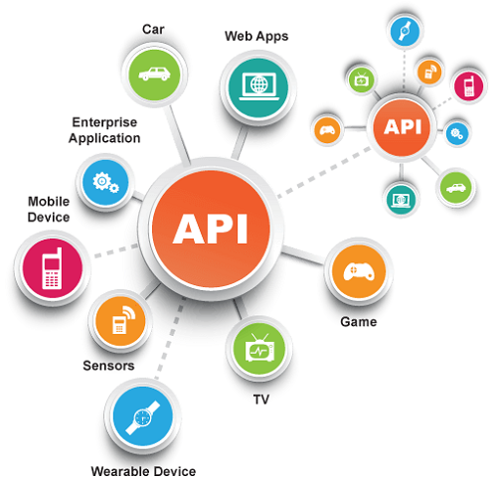

API Testing
Exercises: REST APIs, Postman, C# Unit Testing
SoftUni Team
Technical Trainers
Software University
http://softuni.bg

Slide 2
Have a Question?
sli.do
#QA-Automation
Notes:
2

Slide 3

Test Levels
Unit Testing, Integration Testing, System Testing
Notes:
Software testing is the QA main activity, that ensures the software quality.
In this section, we shall discuss the test types, test levels and the testing process.
We shall explain the different types of tests, involved in software testing,
such as functional and non-functional testing,
black-box and white-box testing,
manual and automated testing.
We shall explain the concept of different test levels, which include
unit testing, integration testing and system testing.
We shall discuss the software testing process, which involves several steps such as:
test planning,
test development
and test execution.
We shall also explain what is a test scenario and how it is covered by several test cases.

Slide 4
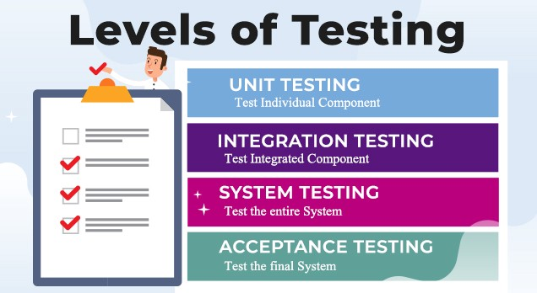
Test Levels
Unit tests
Test a single component (mocking the dependencies)
NUnit, JUnit, Mocha
Integration tests
Test interaction between components, e.g. API tests
System tests / acceptance tests / end-to-end tests
Test the entire system, e.g. Selenium, Appium, Cypress
Notes:
Software testing is done at several levels:
unit testing, integration testing and system testing.
Unit tests test a single component (called "unit").
This can be a function or method in the code, a class or other code component.
For example, a set of unit tests can demonstrate that
the service for registering a new user checks for duplicated username and invalid password
and when the input data is correct, it stores the new user in the user repository.
In this case, the unit test will not use a real database (which is an external component).
Instead it will use a fake implementation (mock) of the functions
for accessing the user repository (the database table holding the users).
This way the unit tests check only certain component,
isolated from the other components, which may not exist at this time.
Unit testing aims to verify each component of the software
by isolating it from the other components
and then perform tests to demonstrate that it works correctly.
When a component is dependent on other components,
the external dependencies are replaced during the testing
by mock objects, stubs or using other techniques.
Unit tests are automated tests, written by developers,
that examine the functionality of single component (or unit).
They are small pieces of code (functions or methods),
which automate the testing of certain unit.
Unit testing is performed at the earliest stages of the development process,
long before the software is developed and ready for testing by QA engineers.
When unit testing is implemented,
for each unit, developers write multiple unit tests,
to cover fully its functionality.
Unit tests are examples of automated, functional, white-box tests,
based on a unit testing framework,
such as JUnit, NUnit or Mocha.
We shall learn how to write simple unit tests with live code examples later.
Integration tests check the interaction between several components.
For example, if we test whether the user registration service in the back-end
correctly stores the new user to the database, this is an integration test.
This integration test checks several components together:
the user registration function in the back-end API,
the data access logic,
and the database.
This integration test does not test the entire system.
It does not care about the front-end and the user interface.
Integration tests are examples of automated, white-box, functional tests,
and are usually based on some unit testing framework.
The difference between unit testing and integration testing is that
unit tests examine the functionality of a single unit and they mock the external dependencies,
while integration tests examine the functionality on several units together
and test the integration between the dependent units.
Unit tests are more-simple than the integration tests
and have smaller scope, usually a single public method (or function).
Integration tests implement more complex scenarios.
They test together multiple interconnected components and subsystems.
Integration testing is performed early in the development process,
after some of the components are written and unit tested,
and they need to be integrated together into modules with more complex functionality.
Integration tests are usually written by developers, not by QAs.
We shall learn how to write simple integration tests with live code examples later.
System tests and acceptance tests test the entire system: all its components together.
System tests are manual or automated tests, which cover end-to-end scenarios:
from the front-end, to the back-end, the database and all other system components.
For example, if we test whether after user registration in the mobile app of complex software system,
the new user is correctly stored in the database at the server side, this is a system test.
This system test checks all system components together:
the user interface (the front-end), which is the mobile app in our scenario,
the back-end services at the server side, which are called by the mobile app,
the data access logic, implemented in the back-end to access the database,
and the database server, which stored the app data.
To implement this system test, QA engineers
run the software in a testing environment,
create a database, holding sample testing data,
run the back-end server-side components,
run the front-end component (the mobile app in our scenario),
fill some data in the user registration form, submit the data,
and check the behavior of the mobile app.
The above steps can either be done by hand (manual system testing)
or can be automated (automated system testing).
Automated system testing can be implemented by using DevOps tools and techniques
to automatically deploy and run the required system components
and perform UI tests in the mobile app, using a mobile testing framework.
System testing is performed late in the development process,
when the entire system is ready or partially ready.
System testing is usually performed by QA engineers or test automation engineers.
Modern development processes integrate system testing in the CI/CD pipeline.
Projects with less QA resources implement automated smoke tests during the system testing phase.
The smoke tests check whether the most important functionality works in the most common scenarios.
They just check whether the system is broken or not, without verifying each of its functions.
An example of smoke test could be to check whether the home page of the system opens correctly.
Projects with more QA resources automate the testing of the entire system
with all its functionality, covering all its use cases.
This approach is heavy and time consuming and is rarely used.
Most modern projects automate the system testing for the most important scenarios,
not the entire system with all its components.
Acceptance testing is an extension to system testing, where
the QA team or the project sponsor checks how the product will perform
when it is installed on the user’s system.
Acceptance tests are usually more intensive and more comprehensive than the system tests
and should cover the entire functionality of the software.
The aim of acceptance testing is to evaluate whether the system complies with the end-user requirements
and if it is ready for deployment in the production environment.

Slide 5
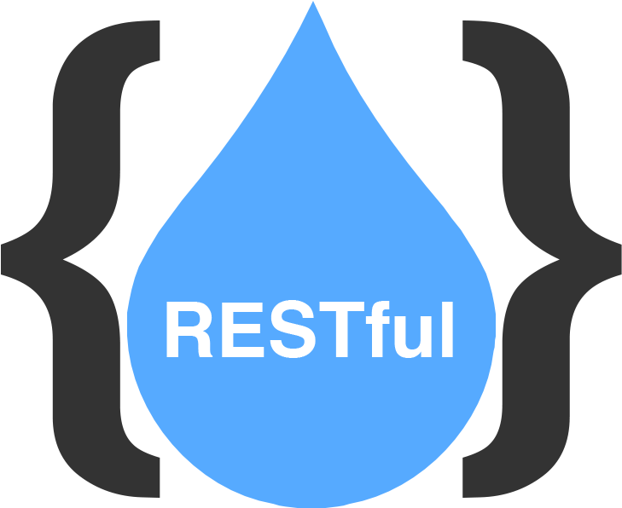
RESTful APIs
HTTP-Based Backend APIs

Slide 6
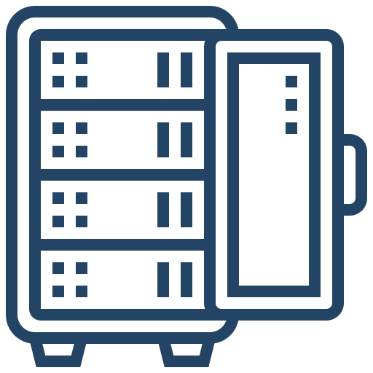

AJAX and RESTful APIs
HTTP is text-based client-server protocol for the Internet
RESTful APIs are HTTP-based Web services (backend apps)
The HTTP methods GET, POST, PATCH and DELETE implement the CRUD operations (retrieve, create, modify and delete data)
GET /api/users
HTTP request
HTTP response
200 OK
HTTP client
HTTP server
Notes:
Now' let's talk about an important Web front-end concept and technology: AJAX.
AJAX stands for "Asynchronous JavaScript and XML".
This acronym doesn't describe its nature well, but this is for historical reasons, from the time when XML was popular.
A better description for the AJAX technology is the following:
AJAX is a technology for asynchronous execution of HTTP requests from client-side JavaScript code.
JavaScript front-end apps use AJAX calls to access the back-end services and APIs and consume data from the Web server over the HTTP protocol.
AJAX enables building interactive single page apps, where the content of the page interactively changes, without refreshing the page.
Developers can retrieve data from a URL without having to do a "full page refresh".
This enables a Web page to update just part of a page without disrupting what the user is doing.
This is an example how JavaScript code can download server-side resources over HTTP using the "fetch" function.
The "fetch" function takes as input a server-side resource URL and returns a promise, which will be resolved when the resource is downloaded, or an error occurs.
This code will invoke asynchronously a simple HTTP GET request.
This is an example how front-end connects to the back-end.
The AJAX technology uses the XMLHTTPRequest browser object to asynchronously make HTTP requests.
Typically, when the data is loaded from the back-end, it is rendered in the DOM tree and this way part of the page is updated dynamically.
In most scenarios the AJAX technology is used to consume RESTful APIs from the back-end server.
RESTful APIs are Web services, invoked through the HTTP protocol.
A "Web service" is remote functionality, that can be invoked over Internet.
REST stands for "Representational State Transfer".
It is an architectural concept and industry standard about how to build Web services.
RESTful services typically implements the CRUD operations (create, read, update, delete) over certain data collection.
The HTTP methods GET, POST, PUT, PATCH and DELETE are used to retrieve, create, replace, modify and delete data.
We shall learn more about RESTful services in the front-end and back-end development modules at SoftUni.

Slide 7







HTTP Request Methods
HTTP defines methods to indicate the desired action to be performed on the identified resource
CRUD == the four main functions of persistent storage
Other Methods
CONNECT
OPTIONS
TRACE
Method | Description
GET | Retrieve a resource
POST | Create / store a resource
PUT | Update (replace) a resource
DELETE | Delete (remove) a resource
PATCH | Update resource partially (modify)
HEAD | Retrieve the resource's headers
Notes:
HTTP defines methods to indicate the desired action to be performed on the identified resource. The most often used HTTP methods are GET, POST, PUT, DELETE and PATCH.
The GET method retrieves a specified resource. It is used to download a Web page, CSS file, script, document or other resource from a Web site.
For example, if you open your favourite news site, its content will be downloaded using HTTP GET requests.
GET can retrieve a list of resources (for example all the news from the front page of a news Web site) or get a single resource (for example, a single news article).
The POST method is used to create (or store) a resource at the Web server.
Remember that POST creates something new at the Web server. It modifies the state at the server-side.
For example, when you login with your username + password at a Web site, the login form uses a POST request to send your credentials to the server and if the login data is valid, the server creates a new session and sends the session identifier as a cookie. We shall learn about "cookies" later, when we study Web programming.
Another example of HTTP POST is when you enter and submit your shipping address in an e-commerce application.
PUT is used to update (or replace) an existing resource. The HTTP PUT method is used in some applications to replace an existing resource with a new version of this resource.
For example, HTTP PUT can be used to change the shipping address in an e-commerce application.
DELETE is used to delete (or remove) an existing resource.
An example of HTTP DELETE request is for deleting an item from the shopping cart in an e-commerce Web application.
The PATCH method updates an existing resource partially. It is used to modify a field of given object.
An example of HTTP PATCH request is for updating the quantity of an order item in the shopping cart in an e-commerce Web application.
The HTTP HEAD method retrieves the resource's headers, without the resource itself.
HEAD is used rarely, for example to check for modifications at the server side.
The four most important operations for most applications are GET, POST, PUT and DELETE, the so-called "CRUD operations".
CRUD is an abbreviation from "create, read, update, delete" and is usually implemented by apps and APIs, which manage persistent data.
Most applications support at least these four CRUD operations for the objects they store, edit and manage.
For example, if you have a phonebook app, you will need at least the following basic operations: view all the entries from the phonebook, view certain phonebook entry, add a new phonebook entry, modify existing phonebook entry and delete a phonebook entry. These are essentially the classical CRUD operations.
HTTP support a few more methods, which are used rarely, in special situations:
CONNECT is used to open a two-way socket connection to the remote Web server. A socket connection can overcome the limitations of the HTTP protocol and its request-response model through lower-level communication.
The OPTIONS method is used to describe the communication options for specified resource. For example, in some situations, the Web client asks the Web server using an HTTP OPTIONS request if it is allowed from a security perspective to request a certain resource. This is called a "cross-origin request" or "CORS".
The HTTP TRACE method is designed for diagnostic purposes during the development and is used very rarely.

Slide 8

Postman
HTTP API Testing Tool

Slide 9
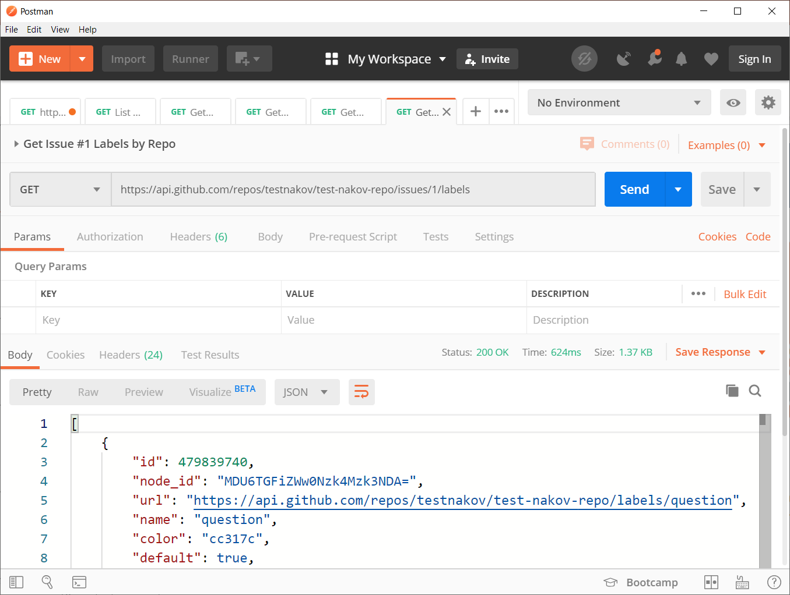

HTTP Developer Tools: HTTP Client Tools
Postman
HTTP client tool for developers
Compose and send HTTP requests
Insomnia Core
Postwoman
Notes:
Let me show you another useful tool for developers who deal with the HTTP protocol: the Postman HTTP client.
Postman is a HTTP client tool for developers. Web developers use it for composing and sending HTTP requests and analyzing the HTTP response from the server, for testing, for debugging server APIs, for researching how to use certain service API and for resolving technical issues during the software development.
With Postman you can create an HTTP request, send it to the Web server, view the HTTP response, and generate a source code to execute the HTTP request in many languages, such as JavaScript, C#, Java, Python, PHP and many others.
Now, lets see an example with Postman. We can send an HTTP request to retrieve the issue #1 from the "aspnetcore" project at GitHub, using the GitHub API, which is accessible via the HTTP protocol.
We create a new request and name it "Get GitHub issue". An we save the request in Postman.
And we choose HTTP method GET for this request.
We enter the following URL for the HTTP request: https://api.github.com/repos/dotnet/aspnetcore/issues/1.
And we click the [Send] button.
The Web server at api.github.com responds with a long JSON object, holding a detailed information about the requested issue.
We can view a code example for sending this HTTP request in JavaScript, C#, Java or other programming language.
We open the [Generate Code Snippets] dialog window by clicking on the [Code] button.
We select [HTTP] to see the HTTP request.
We can select [JavaScript - Fetch] to see how to invoke this request from a client-side JS application, running in the Web browser.
We can select also [Java] to see a sample Java code for invoking the same request from Java.
You can play more with Postman during the exercise and homework sessions. I hope you will like it. I am sure you will find with ease how to install the Postman HTTP client on your computer.
In case you want to explore more the HTTP client tools, I could recommend these:
Insomnia Core REST Client – it is a client HTTP tool for developers, like Postman
Postwoman – it is a Web-based Postman-like HTTP client tool, running directly from the Web, without installation.
Did you notice the tease in the name? It is not a "post man". It is a "post woman". You can play with it at postwoman.io.
This is the tool. We can click on the [Send] button and we see the response here.

Slide 10

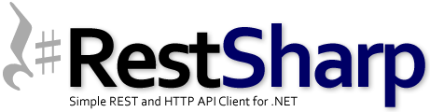
API Testing in C#
Using NUnit and RestSharp

Slide 11
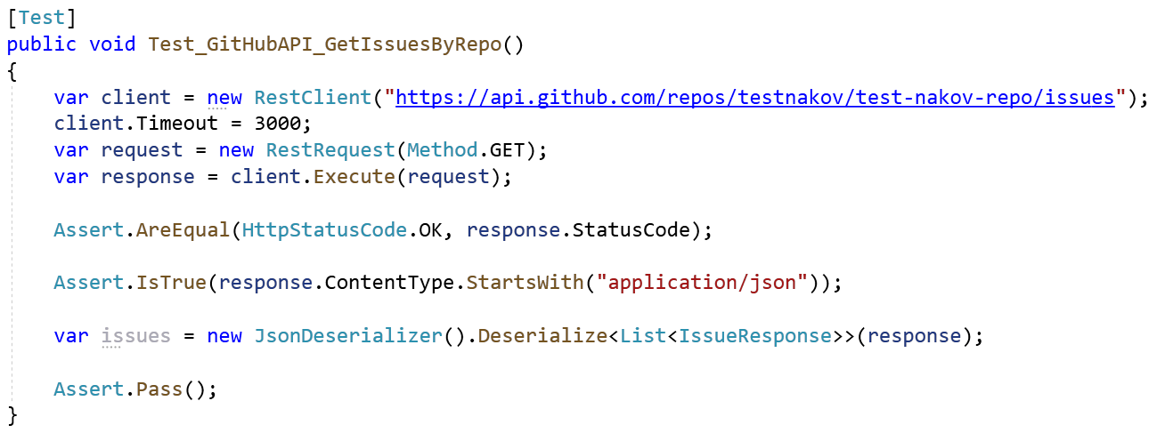
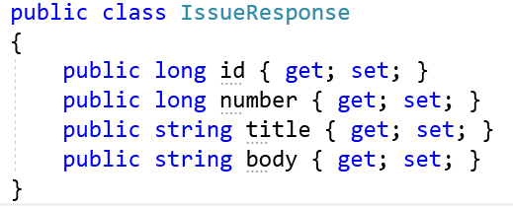
Testing HTTP GET with C# and RestSharp

Slide 12
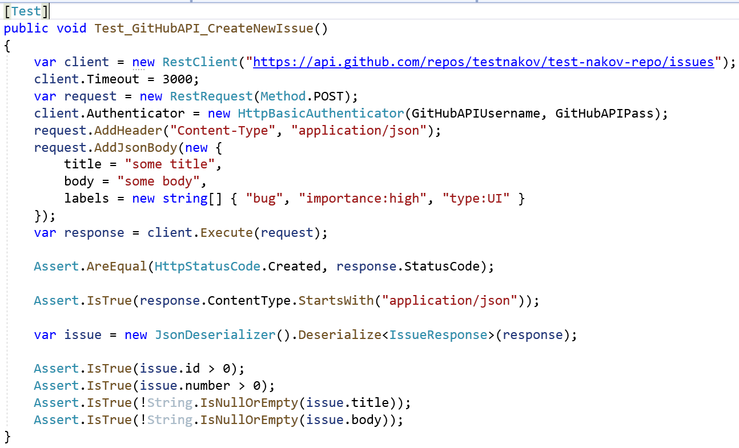
Testing HTTP POST with C# and RestSharp

Slide 13

Summary
HTTP == world's most popular client-server protocol for the Internet
RESTful APIs == HTTP-based Web services
HTTP methods: GET (retrieve), POST (create), PATCH (edit), PUT (replace), DELETE (delete)
Postman == HTTP client tool for API testing
RestSharp == C# library for HTTP requests
Notes:
13

Slide 14
Questions?
Notes:
14

Slide 15




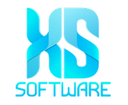









SoftUni Diamond Partners

Slide 16

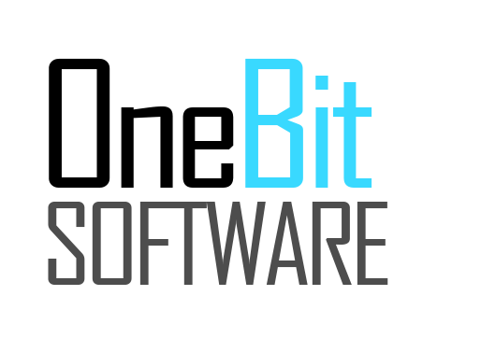


SoftUni Organizational Partners
Notes:
16

Slide 17

License
This course (slides, examples, demos, exercises, homework, documents, videos and other assets) is copyrighted content
Unauthorized copy, reproduction or use is illegal
© SoftUni – https://softuni.org
© Software University – https://softuni.bg
Notes:
17

Slide 18
Trainings @ Software University (SoftUni)
Software University – High-Quality Education, Profession and Job for Software Developers
softuni.bg, softuni.org
Software University Foundation
softuni.foundation
Software University @ Facebook
facebook.com/SoftwareUniversity
Software University Forums
forum.softuni.bg
Notes:
18

